Slide 1

Mistake Proofing & Poka-yoke
A Strategy for Performance Excellence

Slide 2
Performance Excellence Series
Training Module Elements
Executive Overview
Knowledge
Breakthrough
Tools Workbook
Lecture notes
Lecture notes
Participant manual

Slide 3
Table of Contents
Poka-Yoke ( Mistake Proofing)
Session 1.0 Introduction…….……...……………………. 3
Session 2.0 Zero Defects & Costs……………………….. 7
Session 3.0 Waste Management ……………………….. 12
Session 4.0 Zero Defect Quality(ZDQ)…………………. 19
Session 5.0 Understanding Process Errors……………. 27
Session 6.0 Four Elements of ZDQ…………………….. 35
Session 7.0 Seven Steps to Poka-Yoke…………………. 42
Session 8.0 Poka-Yoke Methods……………………….. 44
Session 9.0 Summary……………………………………. 67

Slide 4
Poka-Yoke Concepts
Introduction
Defects & Costs
Waste Management
Zero Defect Quality ( ZDQ)
Understanding Process Errors
Four Elements of ZDQ
Seven Steps To Poka-Yoke Attainment
Poka-Yoke Methods
Summary

Slide 5

Why is “Zero Defects” an Important Concept?
Key Element in our capability to implement Kaizen- Lean Manufacturing Systems.
No need for “just in case” inventories
Allows company to make only what the customer needs.

Slide 6
Why Kaizen
6 Sigma
Data Driven Methodology to Magnify Impact of Process Improvement
Apply Control Techniques to Eliminate Erosion of Improvements
Proceduralize/Standardize Improvements for Improved Maintenance of Critical Process Parameters
Process Improvement Project Implemented
Savings
Maintenance of Process Performance
Time
CPI Project
CPI Projects Emphasize Control and Long Term Maintenance
Savings
Time
Kaizen
Use Small Teams to Optimize Process Performance by Implementing Incremental Change
Apply Intellectual Capital of Team Members Intimate with Process
Kaizen
Savings
CPI
Kaizen Projects Emphasize Incremental Improvements
Time
Notes:
6 Sigma uses a 6 step approach to achieve process performance improvement.
Step 1 Measure Step 4 Verify
Step 2 Evaluate Step 5 Standardize
Step 3 Improve Step 6 Repeat steps 1-5
It is a conceptual strategy of approach utilizing process mapping any number of statistical methods tools to assess efficiency of performance.
Kaizen is a performance improvement methodology focused on identification and elimination of the 7 forms of process waste.

Slide 7
Tool Kit Comparison
Major CPI
Tools (6σ) Kaizen Lean Description
Cp/Cpk  Process capability assessment
DOE Design of experiments
SPC Process control based on statistics and data analysis
FMEA Risk assessment tool
Regression Correlate effect one variable has on another
Process Map   Map process steps to communicate and identify opportunities
5 whys /2 hows                                              Determination methods for root cause discovery
Pareto   Column chart ranking items highest to lowest
Fishbone         Cause / Effect Diagram
5S  Elimination waste
Visual Mgmt        Emphasis on visual techniques to manage process
Poka-Yoke        Error proofing techniques
Spaghetti Chart  
Kanban        Material storage technique used to control process
Takt Time  Determine pace or beat of a process
Std Work  Evaluate tasks done during a process
SMED  Single minute exchange of dies - Quick machine set up
TPM   Integrate maintenance strategy with process
Cellular Flow   Reduce inventory & cycle time through process layout and pull production techniques
Expand Process Improvement Program to Utilize Kaizen Tool Kit
Notes:
Poka-yoke is a key success factor required to achieve 6 sigma and Kaizen improvements, which will eliminate wastes and variation associated with processes.

Slide 8
Poka-Yoke Concepts
Introduction
Defects & Costs
Waste Management
Zero Defect Quality ( ZDQ)
Understanding Process Errors
Four Elements of ZDQ
Seven Steps to Poka-Yoke Attainment
Poka-Yoke Methods
Summary

Slide 9

Why is “Zero Defects” an Important Concept?
Maintain Customer Satisfaction & Loyalty
  Happy Customers mean more sales!

Slide 10

Why is “Zero Defects” an Important Concept?
COST
There is always a cost associated with manufacturing defects!

Slide 11


Costs of Defects ?
Does it cost more to make processes better ? NO
Making processes better leads to reduced
Rework
Scrap
Warranty costs
Inspection costs
Notes:
Eliminating process wastes,such as defects, through implementation of Poka-yoke efforts, will result in more repeatable and reproducible processes.
Thus, processes will be more efficient and be more cost effective.

Slide 12
1-10-100 Rule
The 1-10-100 rule states that as a product or service moves through the production system, the cost of correcting An error multiplies by 10.
Activity Cost
Order entered correctly $ 1
Error detected in billing $ 10
Error detected by customer $ 100
Dissatisfied customer shares the experience with others the costs is
$1000
Notes:
This rule shows the importance and the possible escalation of the costs associated with defects.
The idea is, that as the defective item is processed, the costs increased by a factor of 10 at each successive step.
Theses increases in costs are due to the accumulation of wastes of each successive step as well as the increase in the consumption of resources associated with each additional step in the process.

Slide 13
Poka-Yoke Concepts
Introduction
Defects & Costs
Waste Management
Zero Defect Quality ( ZDQ)
Understanding Process Errors
Four Elements of ZDQ
Seven Steps to Poka-Yoke Attainment
Poka-Yoke Methods
Summary

Slide 14

Why is “Zero Defects” an Important Concept?
Key Element in our capability to eliminate waste.
Defects Misused resources
Inventories Untapped Resources
Motions
Delays
Processes

Slide 15

What is Waste?
Everything we do that
costs something without
adding value to the product
Our objective > Value added = Maximum
Non-Value Added = Minimum
Notes:
What is waste ? Waste is defined here in general terms. Waste does not add value to the products and services we provide and is therefore non-value added. Thus, by the elimination of wastes, we reduce activities that do not add value to the customer and do not contribute to the profits of our organization!
Moreover, when we reduce wastes, we have more time and resources to focus on the value-added activities which are important to our customer and which do contribute the our profits !

Slide 16

The nine types of waste
Overproduction
Delays (waiting time)
Transportation
Process
Inventories
Motions
Defective products
Untapped resources
Misused resources
9 Wastes
Notes:
These are the nine characteristic types of waste affecting process performance.
Everything we do or make that does not add value to the product is waste.
The goal is to minimize wastes, maximize value add.

Slide 17

Continuous Improvement
Is the continuous elimination of waste
Notes:
In order for an organization to continually improve in all aspects of their business, they must eliminate the wastes associated with the processes.

Slide 18
Elimination of Waste
The Method
Identify waste
Check and measure results
Search for causes
Implement continuous improvement
Notes:
As processes are dynamic over time , new wastes appear. The continuous improvement cycle repeats indefinitely in order to address the changing face of waste.

Slide 19
Elimination of Wastes and Continuous Improvement
The Approach
The Means
The Strategy
Elimination of wastes
KAIZEN
Continuous Improvement
One piece flow
SMED
Visual Controls
Workplace Organization
Kanban
Standard Work
Process Control
Total Productive Maintenance
Poka-Yoke
Leadtime
Costs
Quality
the
First Time
Notes:
The focus on elimination of wastes (muda) is the core concept of Kaizen. Several means are employed to achieve the strategy of reducing lead times, costs, and producing quality the first time, every time.

Slide 20
Poka-Yoke Concepts
Introduction
Defects & Costs
Waste Management
Zero Defect Quality ( ZDQ)
Understanding Process Errors
Four Elements of ZDQ
Seven Steps to Poka-Yoke Attainment
Poka-Yoke Methods
Summary

Slide 21

What is a Zero Defect Quality System (ZDQ)?
A quality concept to manufacture ZERO defects & elimination of waste associated with defects!
“ZERO” is the goal!

Slide 22

What is a Zero Defect Quality System (ZDQ)?
Based on a discipline that defects are prevented.
Control the process so that defects are impossible!

Slide 23

What is a Zero Defect Quality System (ZDQ)?
No Finger Pointing.
Operators and Machines will sometimes make mistakes.
Find ways to keep errors from becoming defects!

Slide 24

What is a Zero Defect Quality System (ZDQ)?
A Method for Mistake-Proofing (Poka-yoke) a process.
ZDQ assures that defects are not shipped!

Slide 25

How ZDQ Makes Work Easier
Mistake-Proof or Poka-yoke the process!
Recognize that it is natural for people to make mistakes.

Slide 26

How ZDQ Makes Work Easier
Mistake-Proof or Poka-yoke the process!
Not noticing that an error is made or a machine is not functioning does not make a person stupid or foolish.

Slide 27

How Do We Achieve ZDQ ?
Mistake-Proof or Poka-yoke the process!
Errors never become defects!
No finger pointing after the fact. No mandate to do better next time.

Slide 28
Poka-Yoke Concepts
Introduction
Defects & Costs
Waste Management
Zero Defect Quality ( ZDQ)
Understanding Process Errors
Four Elements of ZDQ
Seven Steps to Poka-Yoke Attainment
Poka-Yoke Methods
Summary

Slide 29

Poka-Yoke results in Quality of Processes
Quality the 1st time
Cost
Leadtime
Transformation = Quality production the 1st time
Inspection….eliminated ???
Transport
Dedicated lines
Storage
One piece flow
Delay/wait
Notes:
If quality is designed into the production process, it may be possible to eliminate inspection.

Slide 30

Relationship between processes and quality defects.
Almost any business activity can be considered a process.
Production processes involve the flow of material. Machining, assembly, and packaging are typical production processes.
Business processes involve the flow of information. Financial planning, purchasing & order entry are typical business processes.
All processes have the potential for defects. Hence, all processes offer a opportunity for the elimination of defects and the resultant quality improvement.
Notes:
Work is a series of interrelated processes.
All processes have variation associated with them.
Variation results in defects.
Defects in one process can lead to defects in another process.
When defects escalate costs escalate.

Slide 31


In order to reduce quality defects and stop
throwing away money, we must
Understand the process an its relationship to other business processes.
Identify the inputs and outputs of the process.
Know who are the suppliers to and customers of the process.
=
Reduce the
variation of the process
And

Slide 32

What Causes Defects?
Process Variation From
1. Poor procedures or standards.
2. Machines.
3. Non-conforming material.
4. Worn tooling.
5. Human Mistakes.
Except for human mistakes these conditions can be predicted and corrective action can be implemented to eliminate the cause of defects

Slide 33

What Causes Defects?
Human Mistakes
Simple errors-the most common cause of defects-occur unpredictably.
The goal of ZDQ is zero! Make certain that the required conditions are in place and controlled to make acceptable product 100% of the time.

Slide 34
Ten Types of Human Mistakes
Forgetfulness
Misunderstanding
Wrong identification
Lack of experience
Willful (ignoring rules or procedure)
Inadvertent or sloppiness
Slowliness
Lack of standardization
Surprise (unexpected machine operation, etc.)
Intentional (sabotage)
Notes:
Mistakes can be assigned to any of ten categories depending on the basis of their origin.

Slide 35
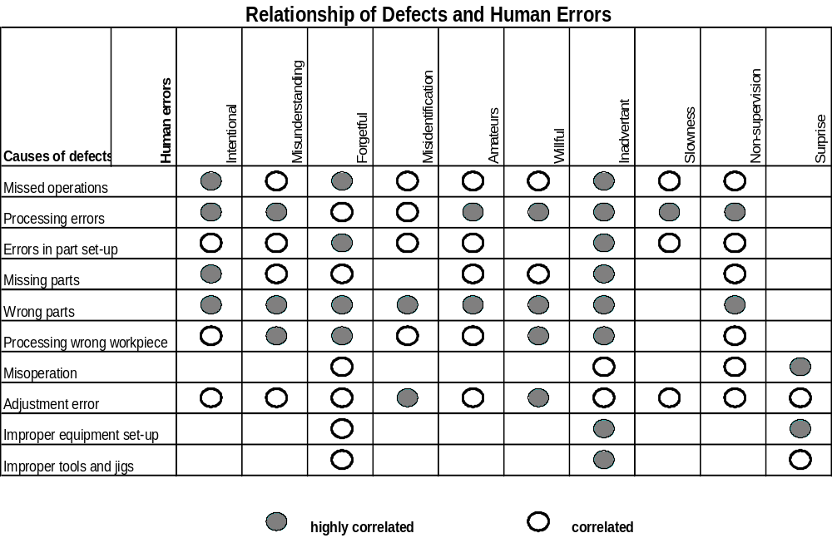
Notes:
The causes of defects correlate to varying degrees with the 10 categories of human error as diagrammed above.

Slide 36
Poka-Yoke Concepts
Introduction
Defects & Costs
Waste Management
Zero Defect Quality ( ZDQ)
Understanding Process Errors
Four Elements of ZDQ
Seven Steps to Poka-Yoke Attainment
Poka-Yoke Methods
Summary

Slide 37

The 4 Components of ZDQ
ZDQ functions by combining four elementary components:
1. Point of Origin Inspection
2. 100 % Audit Checks
3. Immediate Feedback
4. Poka-Yoke

Slide 38
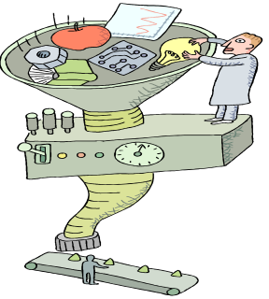
Inspection
The 3 basic approaches to inspection of processed product are:
Judgement/Standard Inspection
Informative Inspection
Point of Origin Inspection
The first two approaches are widely used and considered traditional.
Only Point of Origin Inspection actually eliminates defects.

Slide 39
Point of Origin Inspection
Focus on prevention, not detection.
One of the 4 basic elements of ZDQ.
Differs from Judgement and Informative:
Catches errors
Gives feedback before processing
No risk of making more defective product
May include: Switches that detect miss-fed parts
Pins that prevent miss-feeding
Warning lights
Sound signals
Process with Zero Defects
By combining Check and Do in the ZDQ approach; the Doing is controlled so it cannot be wrong 100% of the time!
Detect Error
Feedback/Corrective Action

Slide 40

ZDQ/Check and Do/Point of Origin Inspection
Point of Origin Inspection
Check for optimum process conditions before processing is done and errors can be made.
Instant feedback.
Corrections made before defects occur.

Slide 41


100% Audit Checks
Point of Origin Inspection on every piece.
The second of the 4 basic elements of ZDQ.
Differs from SQC inspection:
Does not rely on sampling
Prevents defects
Does not assume defects will statistically occur
Zero Defects
100% Audit checks everything on the line!

Slide 42

Quick Feedback
Error correction as soon as possible
The third of the 4 basic elements of ZDQ.
Differs from traditional inspection approaches that:
Correct problems after the process
Address the problem when errors are already defects
In some cases never identify an error has occurred
ZDQ sends the operator a signal and alarms the person that an error has happened!
ZDQ Inspections = Immediate Feedback

Slide 43
Poka-Yoke Concepts
Introduction
Defects & Costs
Waste Management
Zero Defect Quality ( ZDQ)
Understanding Process Errors
Four Elements of ZDQ
Seven Steps to Poka-Yoke Attainment
Poka-Yoke Methods
Summary

Slide 44

The Seven Guidelines to Poka- Yoke Attainment
1.) Quality Processes - Design “Robust” quality processes to achieve zero defects.
2.) Utilize a Team Environment- leverage the teams knowledge,experience to enhance the improvement efforts.
3.) Elimination of Errors -Utilize a robust problem solving methodology to drive defects towards zero.
4.) Eliminate the “Root Cause” of The Errors-Use the 5 Why’s and 2 H’s approach
5.) Do It Right The First Time- Utilizing resources to perform functions correctly the “first” time.
6.) Eliminate Non-Value Added Decisions- Don’t make excuses-just do it !
7.) Implement an Incremental Continual Improvement Approach-implement improvement actions immediately and focus on incremental improvements; efforts do not have to result in a 100% improvement immediately.
Notes:
These are the sevens rules to a successful Poka-yoke implementation, generally in most text you will see 8 guidelines to poka-yoke attainment;we combined two steps into one.
These should be custom fitted to your organization and culture.

Slide 45
Poka-Yoke Concepts
Introduction
Defects & Costs
Waste Management
Zero Defect Quality ( ZDQ)
Understanding Process Errors
Four Elements of ZDQ
Seven Steps to Poka-Yoke Attainment
Poka-Yoke Methods
Summary

Slide 46

Poka-yoke
Mistake-proofing systems
The fourth of the 4 basic elements of ZDQ.
Does not rely on operators catching mistakes
Inexpensive Point of Origin inspection
Quick feedback 100% of the time
“The machine shut down. We must have made an error!”
BEEP!
BEEP!
Most Poka-yoke devices are sensor or jig devices that assure 100% compliance all the time!
BEEP!

Slide 47

Poka-yoke
What is Poke-yoke?
A method that uses sensor or other devices for catching errors that may pass by operators or assemblers.
Poka-yoke effects two key elements of ZDQ:
Identifying the defect immediately ( Point of Origin Inspection)
Quick Feedback for Corrective Action
How effective the system is depends on where it is used: Point of Origin or Informative Inspection.
Poka-yoke detects an error, gives a warning, and can shuts down the process.

Slide 48

Poka-yoke
Poke-yoke and Point of Origin Inspections( Proactive Approach):
A fully implemented ZDQ system requires Poka-yoke usage at or before the inspection points during the process.
Poka-yoke will catch the errors before a defective part is manufactured 100% of the time.

Slide 49

Poka-yoke
Poka-yoke and Informative Inspection( Reactive Approach):
  Check occurs immediately after the process.
  Can be an operator check at the process or successive check at the next process.
  Not 100% effective, will not eliminate all defects.
  Effective in preventing defects from being passed to next process.
Although not as effective as the Source inspection approach, this methodology is more effective than statistical sampling and does provide feedback in reducing defects.

Slide 50

Poka-yoke Systems Govern the Process
Two Poka-Yoke System approaches are utilized in manufacturing which lead to successful ZDQ:
1. Control Approach
Shuts down the process when an error occurs.
Keeps the “suspect” part in place when an operation is incomplete.
2. Warning Approach
Signals the operator to stop the process and correct the problem.

Slide 51
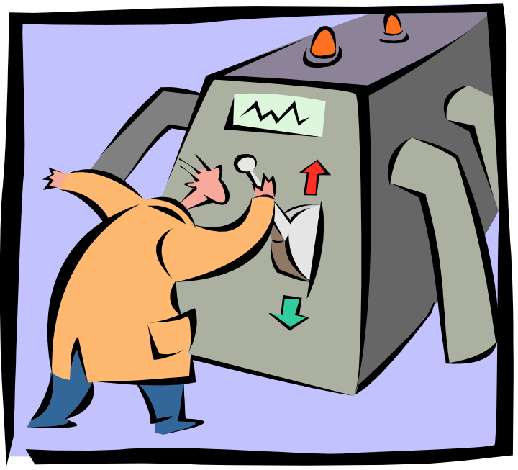
Control System
Takes human element out of the equation;does not depend on an operator or assembler.
Has a high capability of achieving zero defects.
Machine stops when an irregularity is detected.
“There must have been an error detected; the machine shut down by itself!”

Slide 52

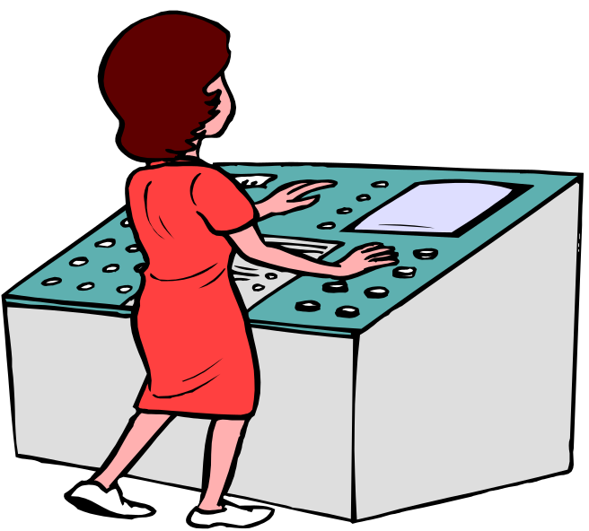
Warning System
Sometimes an automatic shut off system is not an option.
A warning or alarm system can be used to get an operators attention.
Below left is an example of an alarm system using dials, lights and sounds to bring attention to the problem.
Color coding is also an effective non automatic option.
“I’m glad the alarm went off, now I’m not making defects!”
BEEP!
BEEP!
BEEP!

Slide 53

Methods for Using Poka-yoke
Poka-yoke systems consist of three primary methods:
1. Contact
2. Counting
3. Motion-Sequence
Each method can be used in a control system or a warning system.
Each method uses a different process prevention approach for dealing with irregularities.

Slide 54
Contact Method
A contact method functions by detecting whether a sensing device makes contact with a part or object within the process.
Cylinder present
Missing cylinder;piston fully extended alarm sounds
An example of a physical contact method is limit switches that are pressed when cylinders are driven into a piston. The switches are connected to pistons that hold the part in place. In this example, a cylinder is missing and the part is not released to the next process.
Cannot proceed to next step.
Contact Method using limit switches identifies missing cylinder.

Slide 55

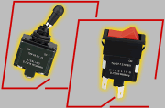
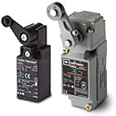

Physical Contact Devices
Toggle Switches
Limit Switches

Slide 56
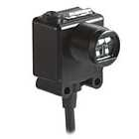
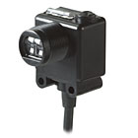
Energy Contact Devices
Photoelectric switches can be used with objects that are translucent or transparent depending upon the need.
Transmission method: two units, one to transmit light, the other to receive.
Reflecting method:PE sensor responds to light reflected from object to detect presence.
Light
Transmitter
Receiver
Object
If object breaks the transmission, the machine is signaled to shut down.

Slide 57
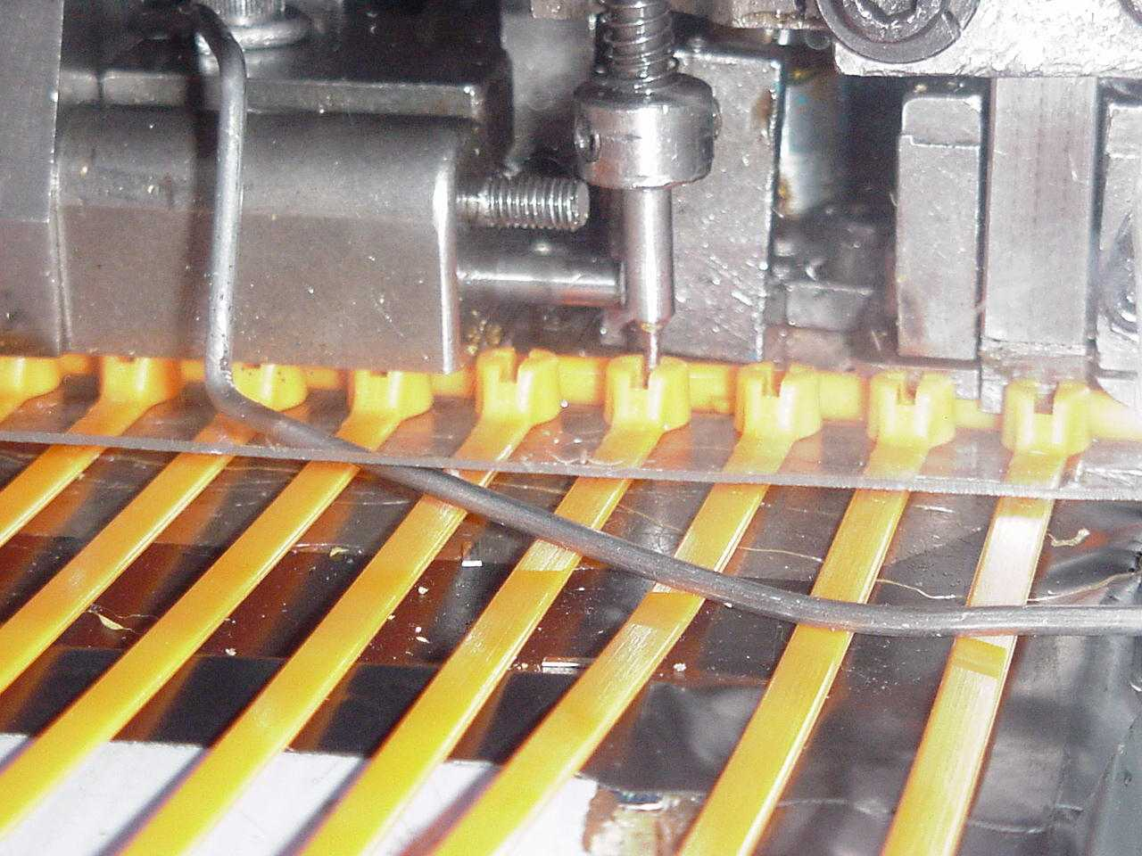
Contact Device
An example of a contact device using a limit switch. In this case the switch makes contact with a metal barb sensing it’s presence. If no contact is made the process will shut down.

Slide 58

Contact Methods
Do not have to be high tech!
Passive devices are sometimes the best method. These can be as simple as guide pins or blocks that do not allow parts to be seated in the wrong position prior to processing
Take advantage of parts designed with an uneven shape!
A work piece with a hole a bump or an uneven end is a perfect candidate for a passive jig. This method signals to the operator right away that the part is not in proper position.

Slide 59
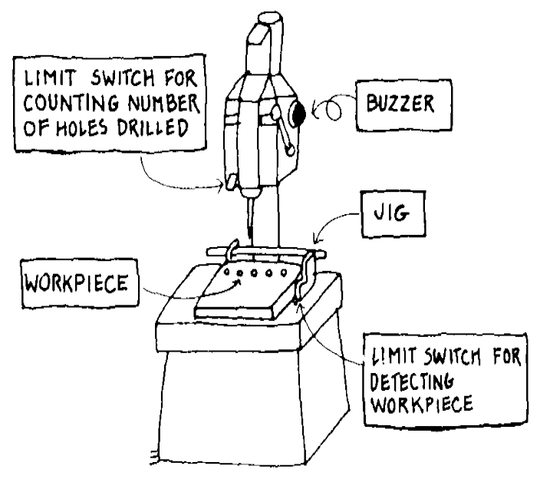
Counting Method
Used when a fixed number of operations are required within a process, or when a product has a fixed number of parts that are attached to it.
A sensor counts the number of times a part is used or a process is completed and releases the part only when the right count is reached.
In the example to the right a limit switch is used to detect and count when the required amount of holes are drilled. The buzzer sounds alerting the operator that the appropriate amount of steps have been taken in the process.

Slide 60

Counting Method
Another approach is to count the number of parts or components required to complete an operation in advance. If operators finds parts leftover using this method, they will know that something has been omitted from the process.
“I have an extra part. I must have omitted a step!”

Slide 61
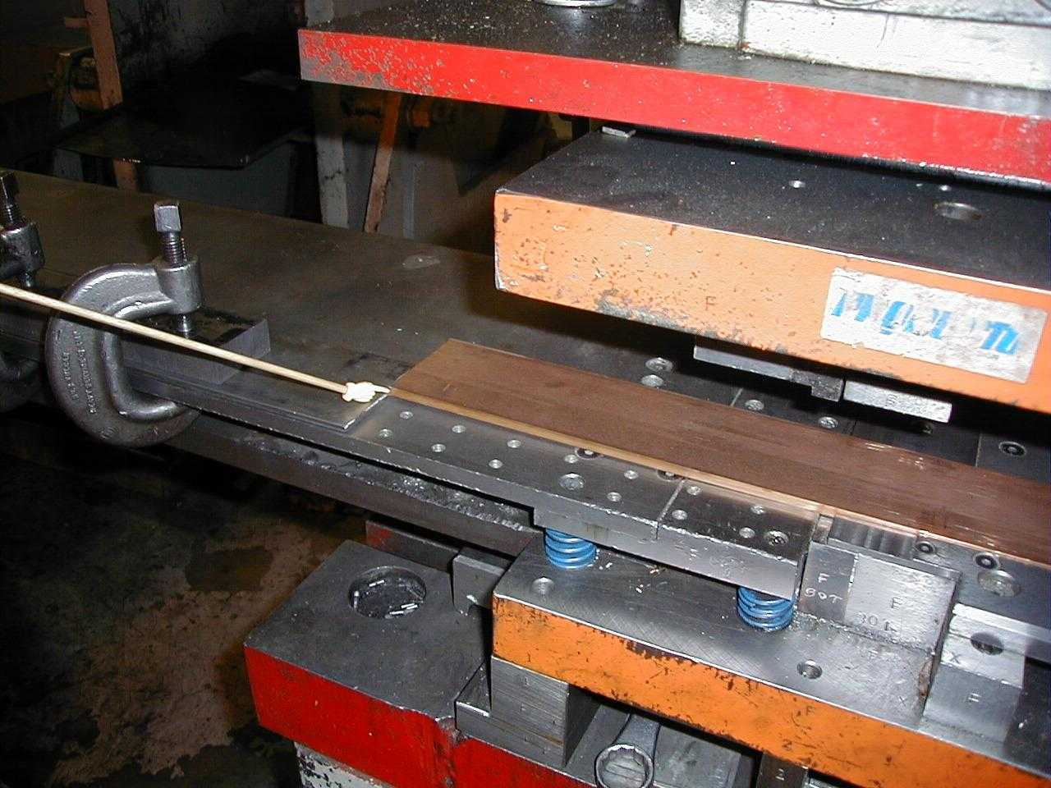
Motion-Sequence Method
The third poka-yoke method uses sensors to determine if a motion or a step in a process has occurred. If the step has not occurred or has occurred out of sequence, the the sensor signals a timer or other device to stop the machine and signal the operator.
This method uses sensors and photo-electric devices connected to a timer. If movement does not occur when required, the switch signals to stop the process or warn the operator.

Slide 62
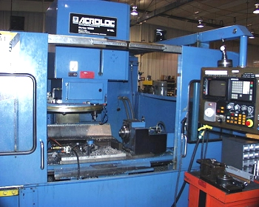
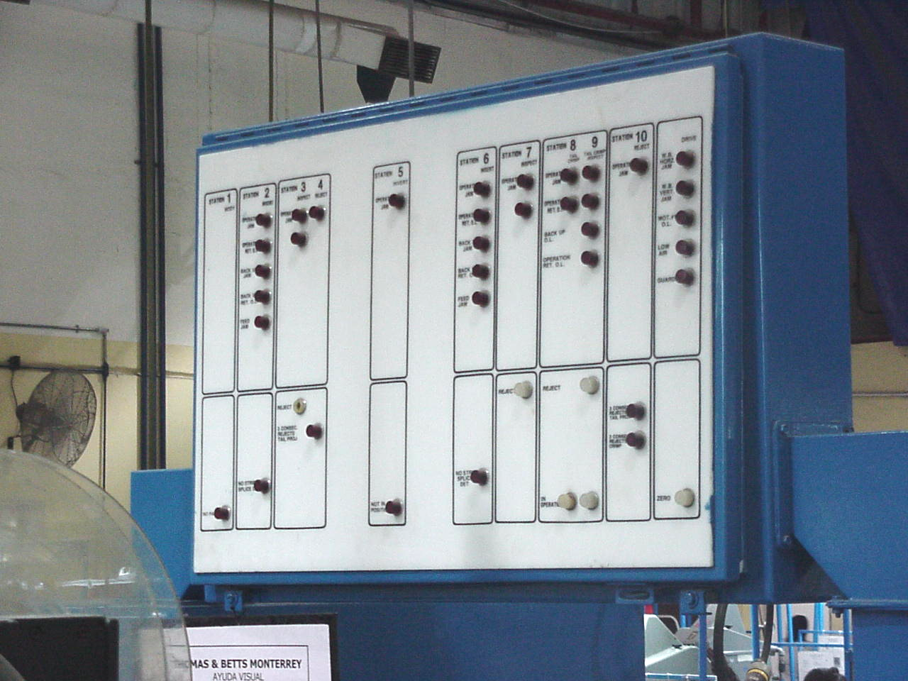
Motion-Sequence Method
In order to help operators select the right parts for the right step in a process the “sequencing” aspect of the motion-step method is used. This is especially helpful when using multiple parts that are similar in size and shape.
In this example, each step of the machine cycle is wired to an indicator board and a timer. If each cycle of the machine is not performed within the required “time” and “sequence”, the indicator light for that step will be turned on and the machine will stop.
Machine
Indicator Board

Slide 63
Types of Sensing Devices
Sensing devices that are traditionally used in poka-yoke systems can be divided into three categories:
1. Physical contact devices
2. Energy sensing devices
3. Warning Sensors
Each category of sensors includes a broad range of devices that can be used depending on the process.
Notes:
Sensing devices are the actual mechanism used to make contact, count, or identify the motion sequence of a work piece. They are the third tier of a poka-yoke system ( tires: approaches-methods-sensing devices).

Slide 64
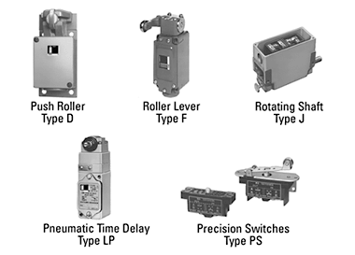
Physical Contact Sensors
These devices work by physically touching something. This can be a machine part or an actual piece being manufactured.
In most cases these devices send an electronic signal when they are touched. Depending on the process, this signal can shut down the operation or give an operator a warning signal.
Notes:
Various examples

Slide 65

Touch Switch
Used to physically detect the presence or absence of an object or item-prevents missing parts.
Used to physically detect the height of a part or dimension.

Slide 66
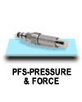
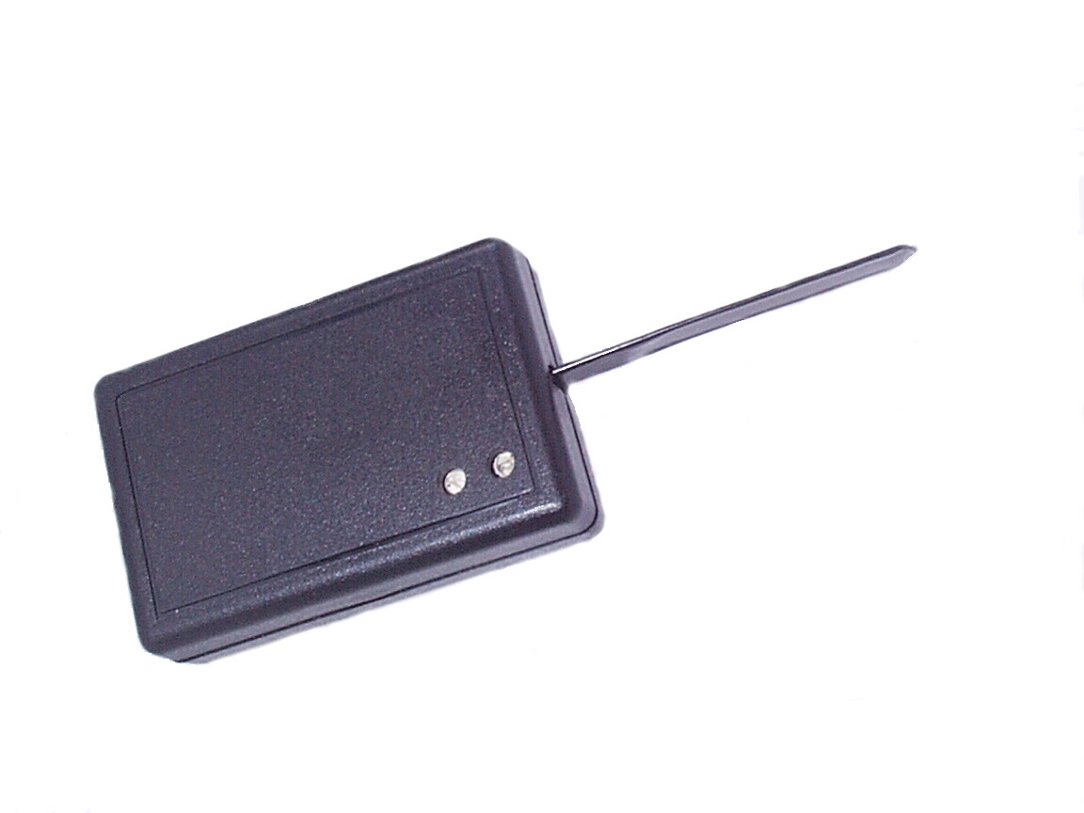
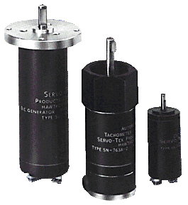
Energy Sensors
These devices work by using energy to detect whether or not an defect has occurred.
Fiber optic
Vibration
Photoelectric

Slide 67
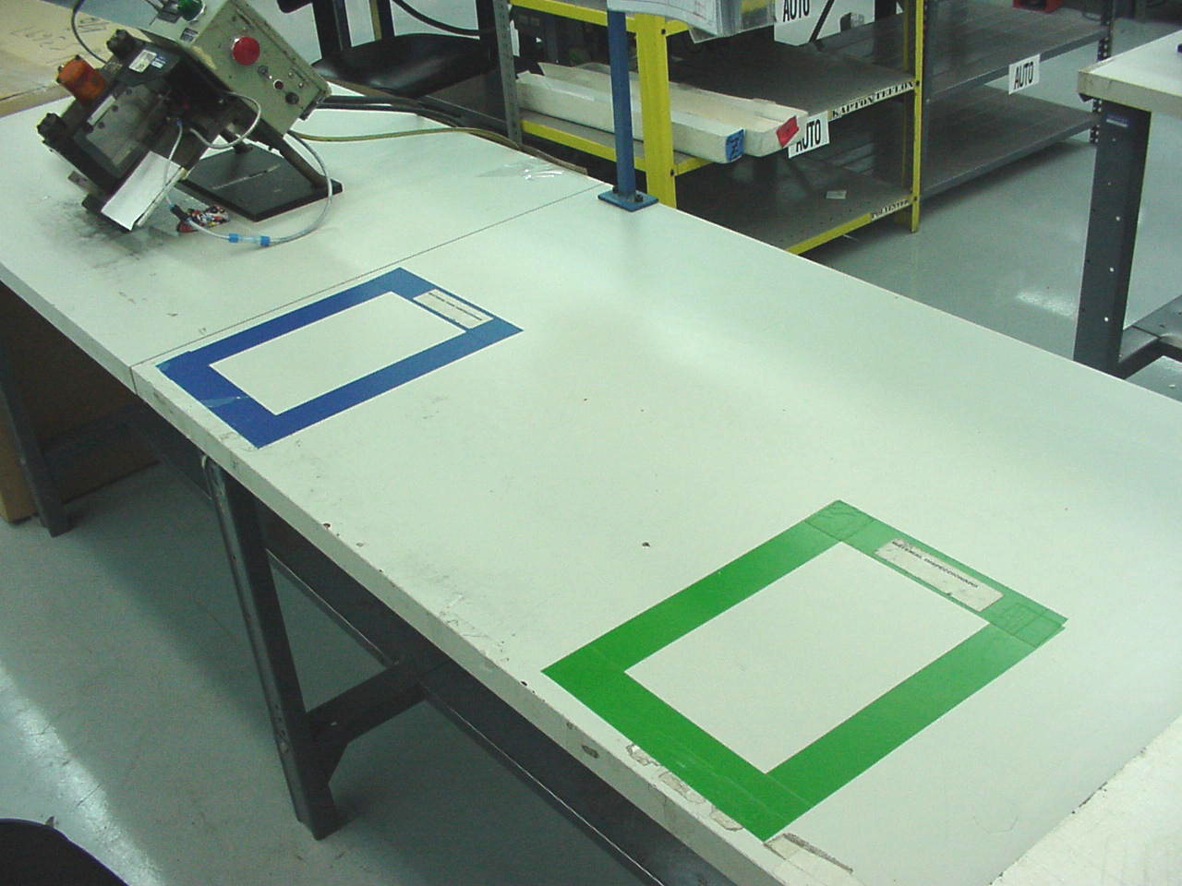
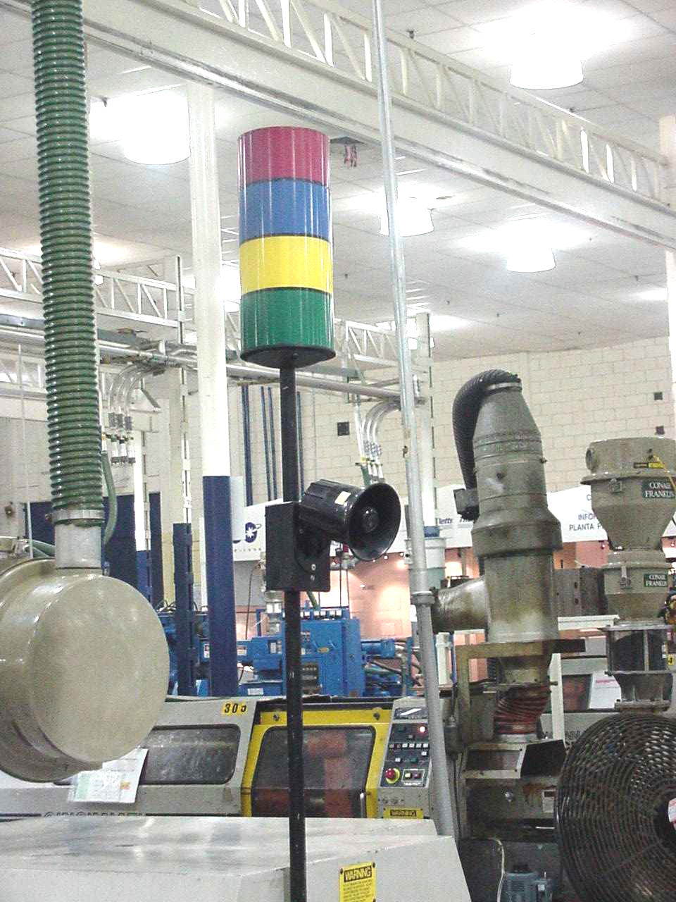
Warning Sensors
Color Code
Warning sensors signal the operator that there is a problem. These sensors use colors, alarms, lights to get the workers attention !
These sensors may be used in conjunction with a contact or energy sensor to get the operators attention.
Lights connected to Micro switches & timers
Lights

Slide 68
Poka-Yoke Concepts
Introduction
Defects & Costs
Waste Management
Zero Defect Quality ( ZDQ)
Understanding Process Errors
Four Elements of ZDQ
Seven Steps to Poka-Yoke Attainment
Poka-Yoke Methods
Summary

Slide 69
To prevent mistakes, develop error proofing devices
POKA-YOKE to avoid (yokeru) inadvertent errors (poka)
Checklists
Dowel and locating pins
Error & alarm detectors
Limit or touch switches
Detectors, readers, meters, counters
Notes:
To prevent mistakes from becoming defects, Poka-Yoke, or error proofing devices build quality into a process.
To avoid (yokeru) inadvertent errors (poka)
Often worker originated

Slide 70


Two types of error proofing devices
POKA-YOKE
Control - eliminates the possibility of a mistake to occur (automatic machine shutdown)
Warning - signals that a mistake can occur (blinking light, alarm, etc.)
Notes:
Control examples : polarized electrical plug, gas pump nozzle, car transmission must be in park in order to start engine.
Warning examples : disc brake pad noise when pad becomes thin, alarm for car lights left on after engine is turned off.

Slide 71
3 Rules of POKA-YOKE
Don’t wait for the perfect POKA-YOKE. Do it now!
If your POKA-YOKE idea has better than 50% chance to succeed…Do it!
Do it now….improve later!
Notes:
Adopt a bias for action, avoid paralysis by analysis

Slide 72
Some examples of POKA-YOKE devices
Attached gas cap
Gas pump nozzle
Polarized electrical plug and socket
Disc brake pad warning noise
Notes:
Ask others to give more examples from their experience

Slide 73
Source Inspection
Detects mistakes before they become defects
Transformation = Quality production the 1st time
Inspection….eliminated ???
Transport
Dedicated lines
Storage
One piece flow
Delay/wait
Notes:
Building quality into the process design so that mistakes are detected before they become defects is the road to quality the first time, every time.

